Slide 1
Object Oriented Programming
Prof. Varsha Dange

Slide 2
Section 2 Lecture – 25
Prof. Varsha Dange

Slide 3
Interface in Java
An interface is a fully abstract class.
It includes a group of abstract methods (methods without a body).
There can be only abstract methods in the Java interface.
From Java 8, interface can have default and static methods too.
interface in java is abstract by default. So, it is not compulsory to write abstract keyword with an interface.
A class can implement any number of interfaces in Java.

Slide 4
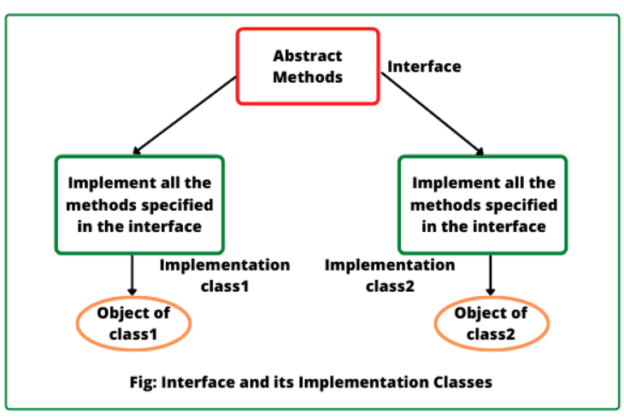
Interface in Java
class that implements an interface is called implementation class.
Every implementation class can have its own implementation for abstract methods specified in the interface

Slide 5
Why do we use Interface?
In industry, architect-level people create interfaces, and then it is given to developers for writing classes by implementing interfaces provided.
Using interfaces is the best way to expose our project’s API to some other projects.
Programmers use interface to customize features of software differently for different objects.

Slide 6
Why do we use Interface?
It is used to achieve full abstraction in java.
By using interfaces, we can achieve the functionality of multiple inheritance.

Slide 7
Declare Interface
In Java, an interface is declared syntactically much like a class.
It is declared by using the keyword interface followed by interface name.
Java compiler automatically adds public and abstract keywords before to all interface methods.
it also adds public, static, and final keywords before interface variables.

Slide 8
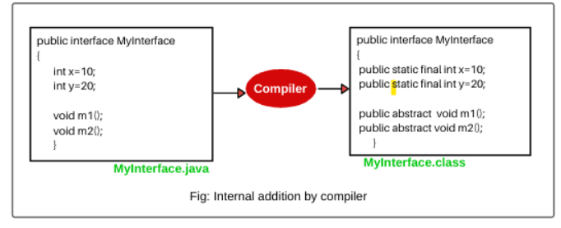
Declare Interface
Therefore, all the variables declared in an interface are considered as public, static, and final by default and acts like constant. We cannot change their value once they initialized.

Slide 9
Features of Interface
Interface provides pure abstraction in java.
It also represents the Is-A relationship.
It can contain three types of methods: abstract, default, and static methods.
Interface cannot have constructors.
The interface is the only mechanism that allows achieving multiple inheritance in java.
It cannot be instantiated just like the abstract class.
To use an interface, other classes must implement it.
use the implements keyword to implement an interface.

Slide 10
Rules of Interface
An interface cannot be instantiated directly.
But we can create a reference to an interface that can point to an object of any of its derived types implementing it.
An interface may not be declared with final keyword.
It cannot have instance variables. If we declare a variable in an interface, it must be initialized at the time of declaration.
A class that implements an interface, must provide its own implementations of all the methods defined in the interface.
An interface can be declared within another interface or class. Such interfaces are called nested interfaces .

Slide 11
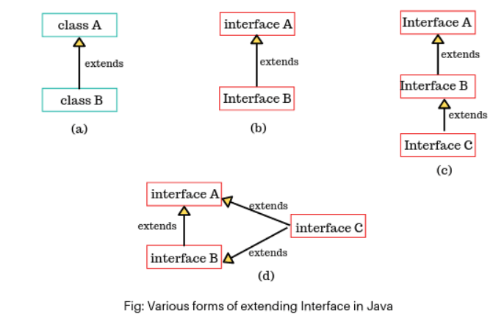
Extending Interface
Like classes, an interface can also extend another interface.
It can be done by using the keyword “extends”.
An interface cannot extend classes because it would violate rules that an interface can have only abstract methods and constants.
An interface can extend Interface1, Interface2.

Slide 12
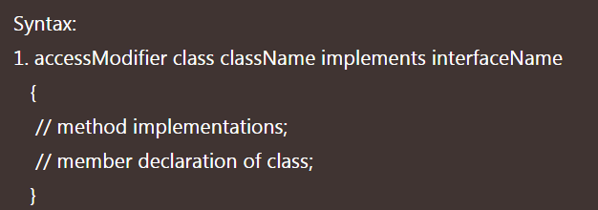
Implementing Interface
An interface is used as “superclass” whose properties are inherited by a class.
A class can implement one or more than one interface by using a keyword implements followed by a list of interfaces separated by commas.
When a class implements an interface, it must provide an implementation of all methods declared in the interface and all its super interfaces.

Slide 13
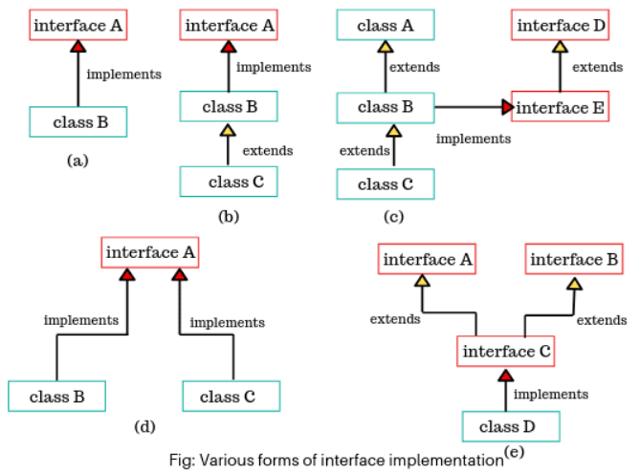
Implementing Interface

Slide 14
Examples
Example1
Example2(Polymorphism in Java Interface)
Example3(Multilevel Inheritance)
Example4(Multiple Inheritance)

Slide 15
Contd…
In Java, Multiple Inheritance is not supported through Class but it is possible by Interface, why?
multiple inheritance, subclasses are derived from multiple super classes.
If two super classes have the same method name then which method is inherited into subclass is the main confusion in multiple inheritance
That’s why Java does not support multiple inheritance in case of class.
But, it is supported through an interface because there is no confusion. This is because its implementation is provided by the implementation class.
Example

